Slide 1

MH-206
ENTREPRENEURSHIP
UNIT-01
Prepared by:
AMIT KUMAR DUBEY
DEPARTMENT OF MANAGEMENT & HUMANITIES

Slide 2

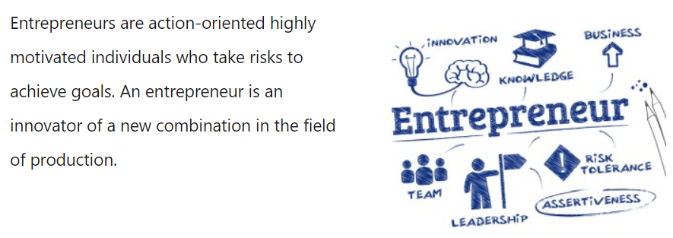

Slide 3
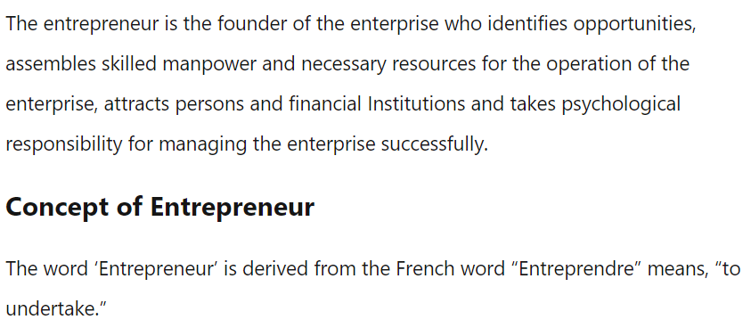

Slide 4
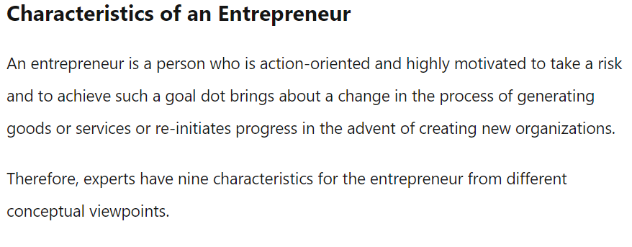

Slide 5

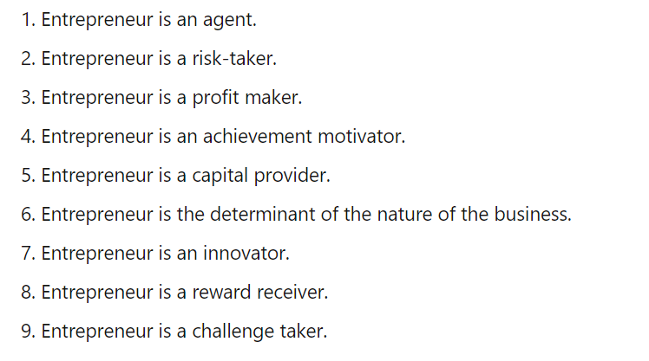
CHARACTERISTICS OF AN ENTREPRENEUR.

Slide 6
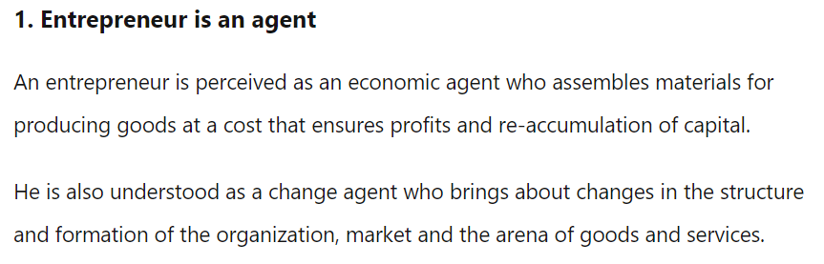

Slide 7
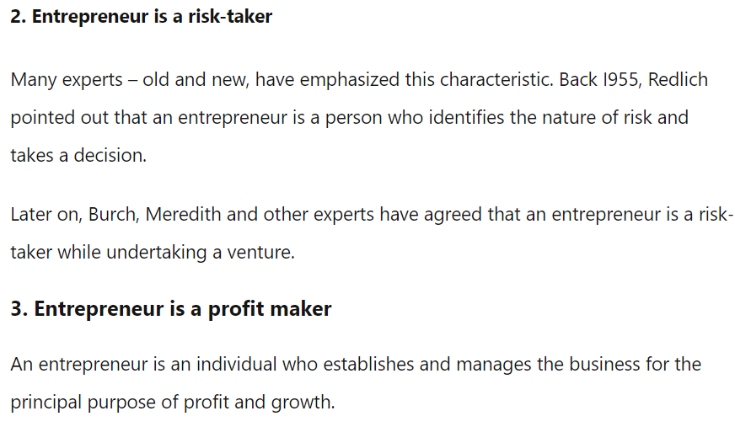

Slide 8

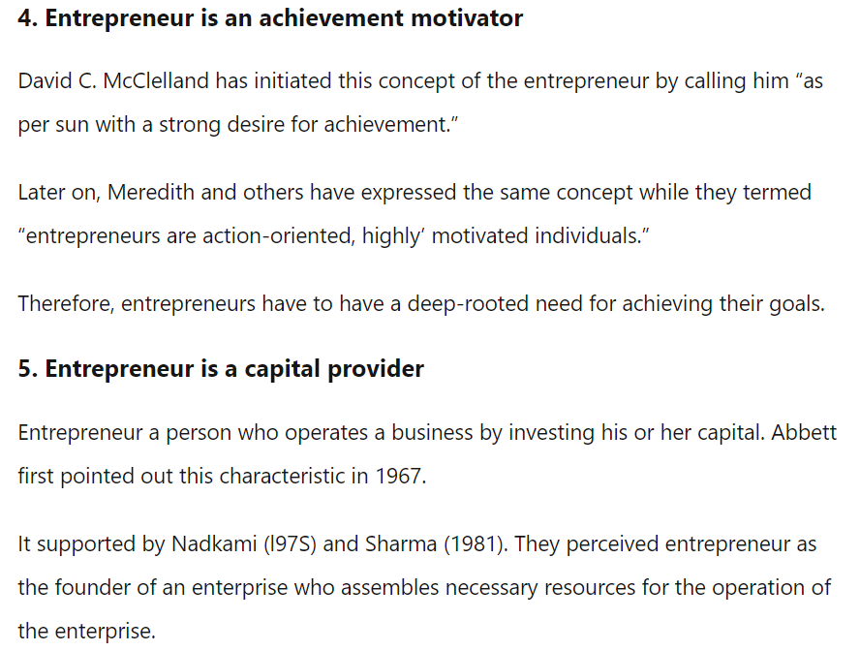

Slide 9
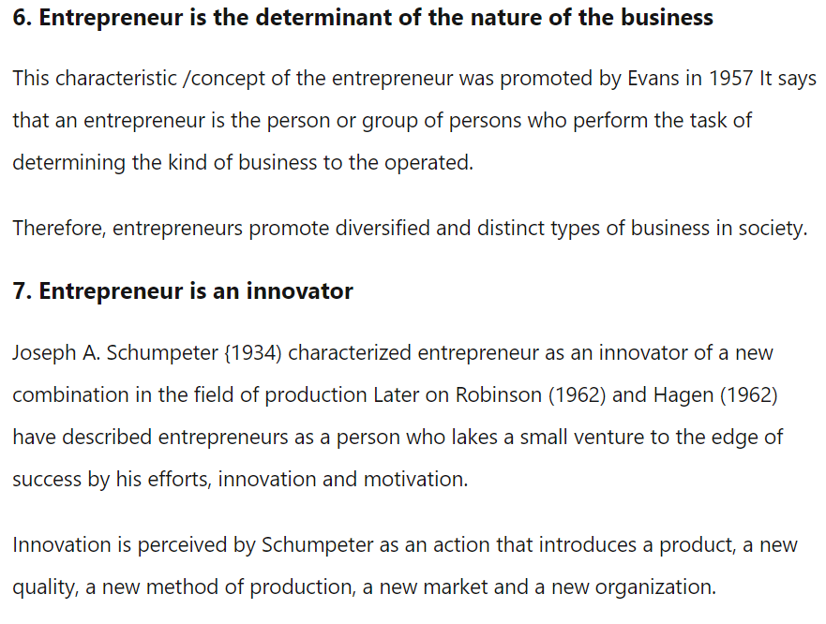

Slide 10
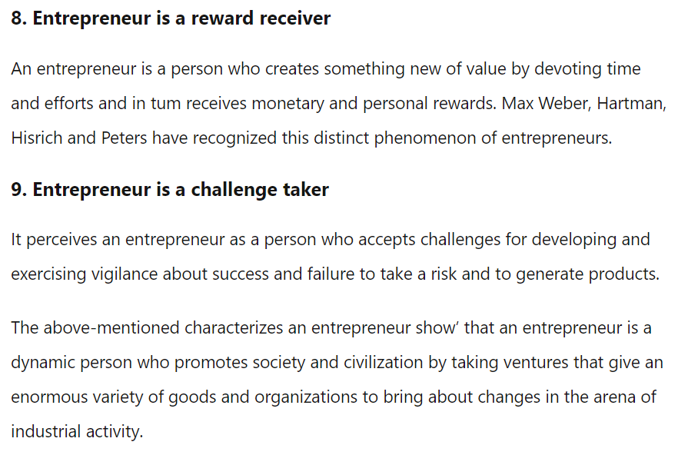

Slide 11
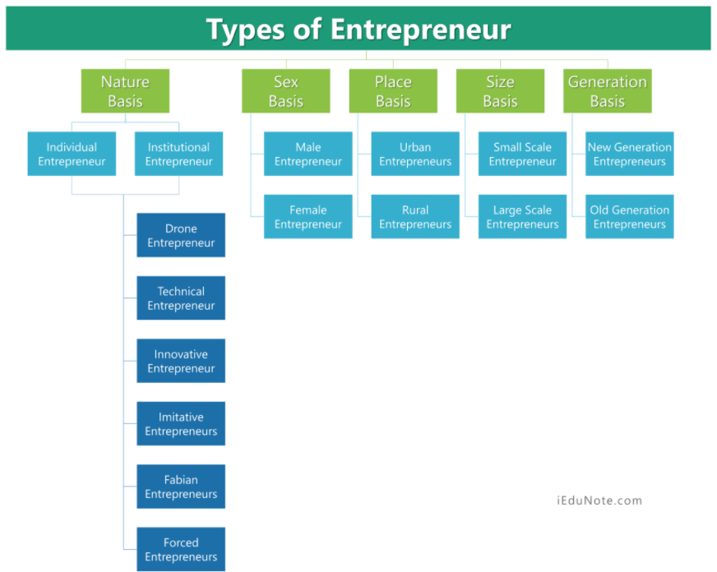

Slide 12
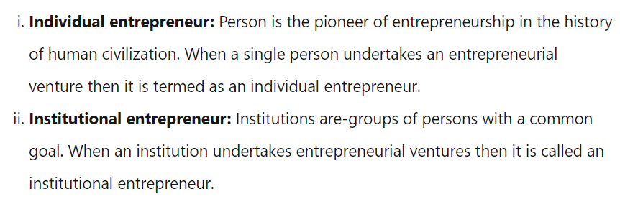

On the basis of Nature
Individual Entrepreneur

Slide 13
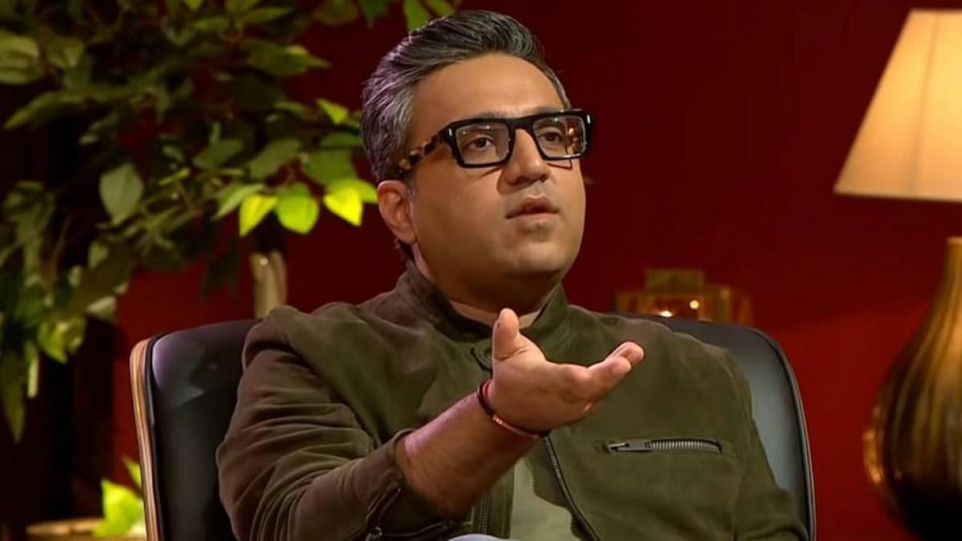
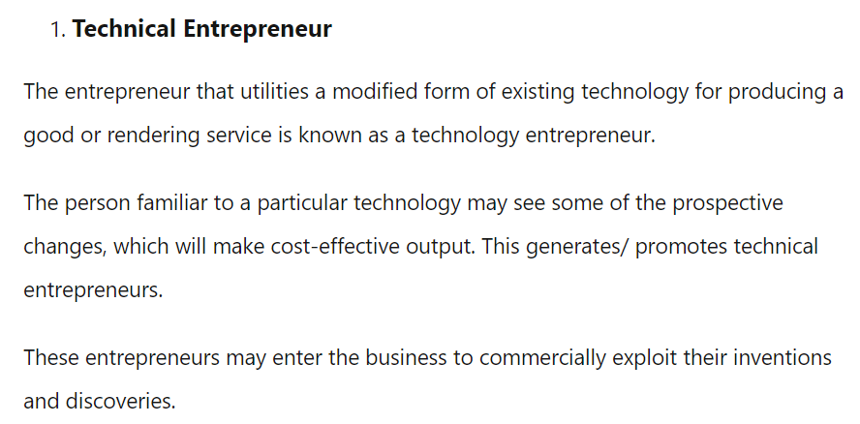

Slide 14
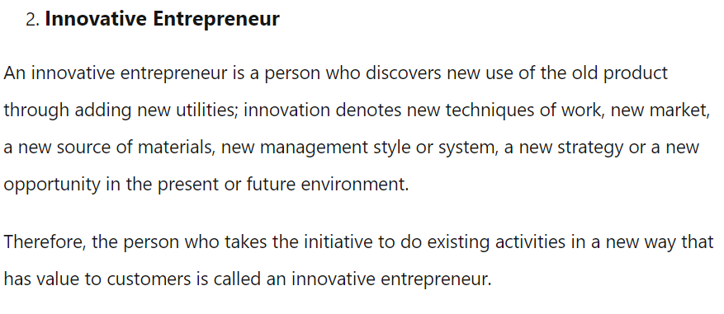



Slide 15
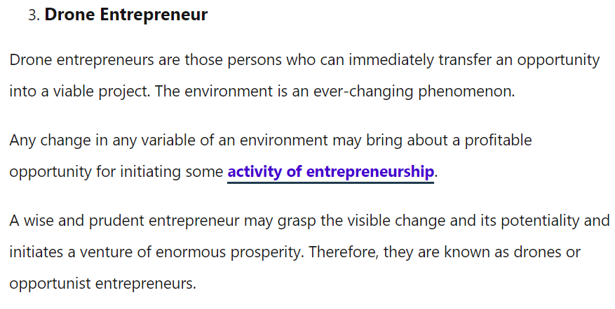
Anupam Mittal
Aman Gupta
Namita Thapar

Slide 16
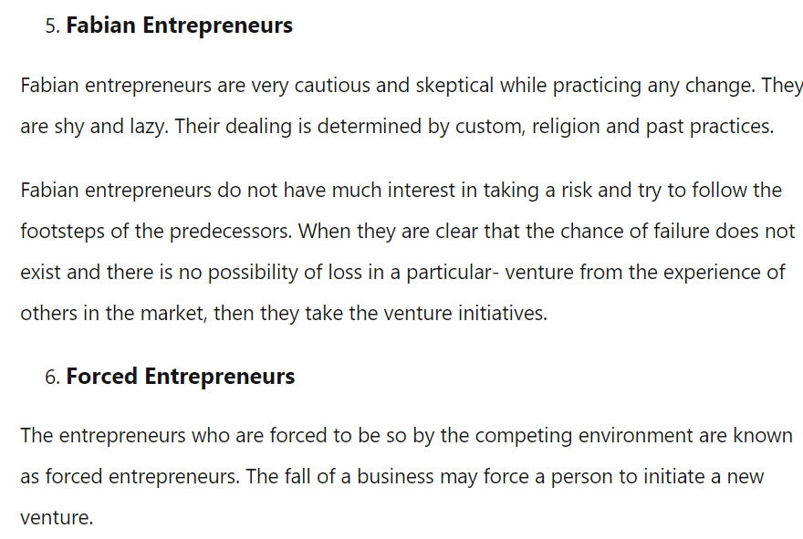
No option other than continuing your own business

Slide 17
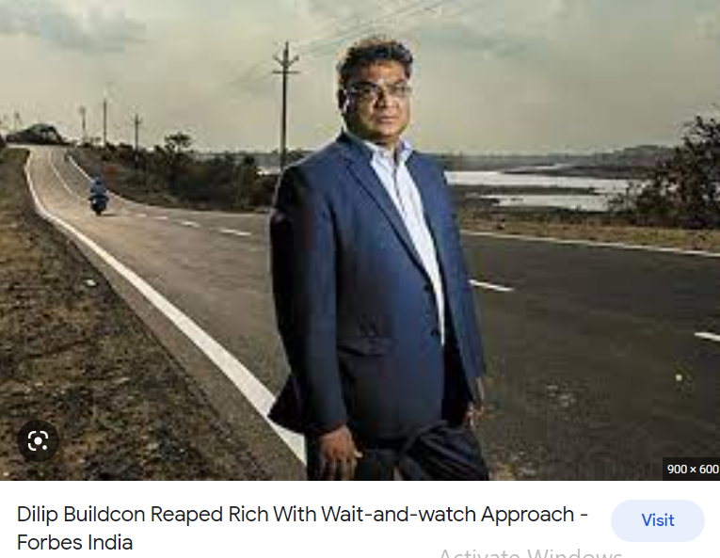
Fabian Entrepreneur

Slide 18
Stages of entrepreneurial process:
Discovery
Concept development
Resourcing
Actualization
Harvesting
1. Discovery: The stage in which entrepreneur develops an ideas, recognizes opportunities, and studies the market. It comprises of innovation and opportunities. Examples of discovery stage are as follows:
Consider consumer needs and wants
Study demographics
Conduct surveys and questionnaires to know the market.
2. Concept development: This stage aims at developing a business plan in which a detailed proposal describing the business idea will be covered. Examples of Concept development are a s follows:
Choose business location
Will a patent or trade mark be required?
3. Resourcing: It is the stage in which the entrepreneur identifies and acquires the financial, human and capital resources needed for the venture start ups etc. Examples of resourcing are as follows:
Identify potential investors
Apply for loans, grants and assistance from the government
Hire employees.

Slide 19
4. Actualization: The stage in which the entrepreneur operates the business and utilizes resources to achieve its goals/objectives. Examples of actualization are as follows:
Grand opening
Day to day operations
5.Harvesting: The stage in which the entrepreneur decides on ventures future growth, development or expansion. Examples of harvesting are as follows:
What is your 5 years or 10 years plans?
Consider adding locations or providing different products/ services
Will you go public in form of IPO?
NOTE: Survival for first three years is very crucial.

Slide 20
Qualities of a Successful Entrepreneurs
Creativity
Professionalism
Risk-Taking
Passion
Planning
Knowledge
Social skills
Open Mindedness towards learning, people and even failures
Empathy
Customers is everything.

Slide 21
CREATIVITY
Creativity gives birth to something new. Without creativity there is no innovation possible. Entrepreneurs usually have the knack to pin down a lot of ideas and act on them. Not necessarily every idea might be a hit. But the experience is gold. Creativity helps in coming up with new solutions for the problems at hand and allows one to think of solutions that are out of the box.

Slide 22
PROFESSIONALISM
Professionalism is a quality which all good entrepreneurs must possess. An entrepreneurs mannerism and behavior with their employees and client goes a long way in developing the culture of the organization. Along with professionalism comes reliability and discipline. Self discipline enables an entrepreneur to achieve their targets, be organized and set examples for everyone.

Slide 23
RISK TAKING
A risk taking ability is essential for an entrepreneur. Without the will to explore the unknown , one cannot discover something unique. And this uniqueness might take all the difference. Risk-taking involves a lot of things. Using unorthodox methods is also a risk. Investing in ideas , nobody else believes in. Entrepreneur have a differential approach towards risks. Good entrepreneurs are always ready to invest their time and money. But they always have a backup for every risk they take.

Slide 24
PASSION
Your work should be your passion. So when you work, you enjoy what you are doing and stay highly motivated. Passion acts as a driving force, with which you are motivated to strive for better. It also allows you the ability to put in those extra hours in the office which can or may make a difference. At the beginning of every entrepreneurial venture or any venture, there are hurdles but your passion ensures that you are able to overcome these roadblocks and forge ahead towards your goals.

Slide 25
PLANNING
Perhaps, this is the most important of all steps required to run a show. Without planning, everything would be a loose string as they say, “ you fail to plan, you plan to fail.”
Planning is strategizing the whole game ahead of time. It basically sums up all the resources at hand and enables you to come up with a structure and a thought process for how to reach your goal.

Slide 26
Knowledge
Knowledge is the key to success. An entrepreneur should possess complete knowledge of his niche or industry. It is the knowledge only through which problem can be solved and crisis can be tackled.
It enables entrepreneur to keep track of the developments and the constantly changing requirements of the market that he is in. may it is a new trend in the market or an advancement in technology or even a new advertiser’s entry, an entrepreneur should keep himself abreast of it. Knowledge is the guiding force when it comes leaving the competition behind. New bits and pieces of information may just prove as useful as a newly devised strategy.

Slide 27
Social skills
A skill set is an arsenal with which an entrepreneur makes his business work. Social skills are also needed to be a good entrepreneur. Overall, these make up the qualities for an entrepreneur to function. Social skills involves the following:
Relationship building
Hiring and talent sourcing
Team strategy formulation.

Slide 28
Open mindedness towards learning, people and even failure:
An entrepreneur must be accepting. The true realization of which scenario or event can be a useful opportunity is necessary. To recognize such openings, an open minded attitude is required.
An entrepreneur should be determined. He should face his losses with a positive attitude and his wins, humbly. Any good businessman know not to frown on a defeat. s/he should try to succeed with the right mentality. Failure is a step a way which didn’t work according to the plan. Good entrepreneur takes the experience of this setback and work even hard with the next goal in line.

Slide 29
Empathy
Perhaps the least discussed value in the world today is empathy or having high emotional intelligence. Empathy is the understanding of what goes on in someone’s mind. This skill is worth a mention. A good entrepreneur should know the strengths and weaknesses of every employee who works under him. Unhappy employees are not determined and as an entrepreneur, it is up to the entrepreneur to create a working environment where people are happy to come.

Slide 30
Customer is everything
A good entrepreneur will always know how to grab a customer’s attention . This can be done through various mediums such as marketing and advertising.
It is also important that an entrepreneur know the needs of the customers. The product or service which is being created by your organisation needs to cater the needs of your consumers. Personalizing business of consumers will also boost the same. The ability to sell yourself in front of a potential investment when it comes in the form of a customer is also required. Being ready with the knowledge to please a customers , is a way to have a successful business.

Slide 31
Problems/ challenges faced by an Entrepreneur
Cash flow management
Hiring employees
Time management
Delegating tasks
Deciding what to sell
Marketing strategy
Arranging finances
Business growth/ expansion
Strapped budget
Self doubt

